Slide 1
Managing Files with Talend Open Studio
February 15, 2018
Presenter:

Slide 2
Managing Files with Talend Open Studio
Managing local files
Copying, removing, renaming and deleting files
Checking file Properties (tFileProperties)
Listing files in a directory (tFileList)
Checking for files (tFileExist)
Archiving and un archiving files (tFileArchive, tFileUnarchive)
FTP file operations

Slide 3
Managing local files
Talend has provided many components for local file operations.
tFileList
tFileCopy
tFileProperties
tFileDelete
tFileExists
tFileArchive
tFileUnarchive

Slide 4
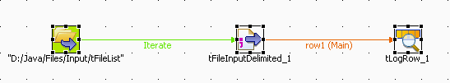
tFileList
tFileList iterates on files or folders of a set directory.
CURRENT_FILE: uses the current file name..
CURRENT_FILEDIRECTORY: uses the current file directory.
CURRENT_FILEEXTENSION: uses the extension of the current file.
CURRENT_FILEPATH: uses the current file name as well as its path.
NB_FILE: uses the number of files iterated upon so far.

Slide 5

tFileCopy
tFileCopy copies a source file into a target directory and can remove th source file if required.
To move file so that original file is deleted, check option “Remove source file”
To rename a file, check on “Rename” and provide a new filename.
DESTINATION_FILENAME: Retrieves the name of the destination file.
DESTINATION_FILEPATH: Retrieves the path to the destination file.
SOURCE_DIRECTORY: Retrieves the path to the source directory.
DESTINATION_DIRECTORY: Retrieves the path to the destination directory.

Slide 6

tFileDelete
It is really useful to be able to delete files. For example, once they have been transformed or processed into other systems.
DELETE_PATH: Returns the path to the location from which the item was deleted.
CURRENT_STATUS: Indicates whether an item has been deleted or not.

Slide 7
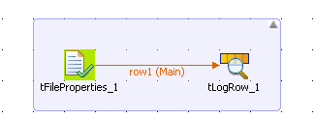
tFileProperties
tFileProperties creates a single row flow that displays the properties of the processed file.

Slide 8
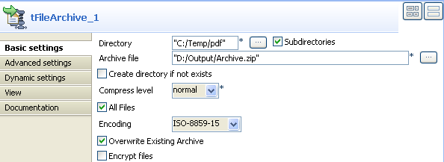
tFileArchive
The tFileArchive zips one or more files according to the parameters defined and places the archive created in the selected directory.
ARCHIVE_FILEPATH: Retrieves the path to the archive file.
ARCHIVE_FILENAME: Retrieves the name of the archive file.

Slide 9
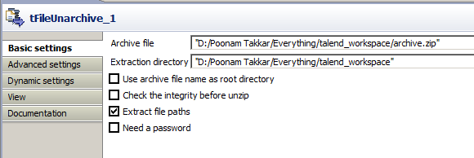
tFileUnarchive
tFIleUnarchive decompresses the archive file (*.tar.gz , *.tgz, *.tar, *.gz and *.zip) provided as parameter and puts it in the extraction directory.
CURRENT_FILE: uses the name of the decompressed archive file.
CURRENT_FILEPATH: uses the path to the decompressed archive file.

Slide 10
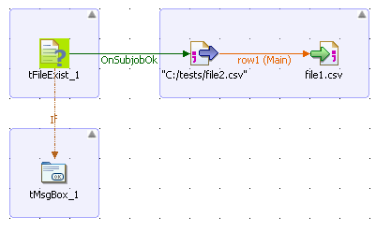


tFileExist
tFileExist checks if a file exists or not. We can use EXISTS component variable(Boolean value) to check the return value from this component.
EXISTS: Indicates whether a specified file exists or not. It returns a Boolean value:.
- true if the file exists.
- false if the file does not exist.
FILENAME: Retrieves the name and path to a file. It returns a string.

Slide 11
FTP File Oprations
The Studio supports many FTP actions—for example, Get, Put, Delete, Rename, File List, File Exist, and so on—and we'll look at how to use some of these in this section.

Slide 12
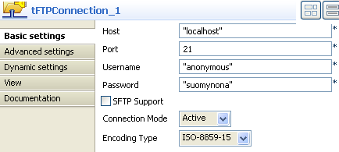
tFTPConnection
tFTPConnection opens an FTP connection in order that a transaction may be carried out.

Slide 13
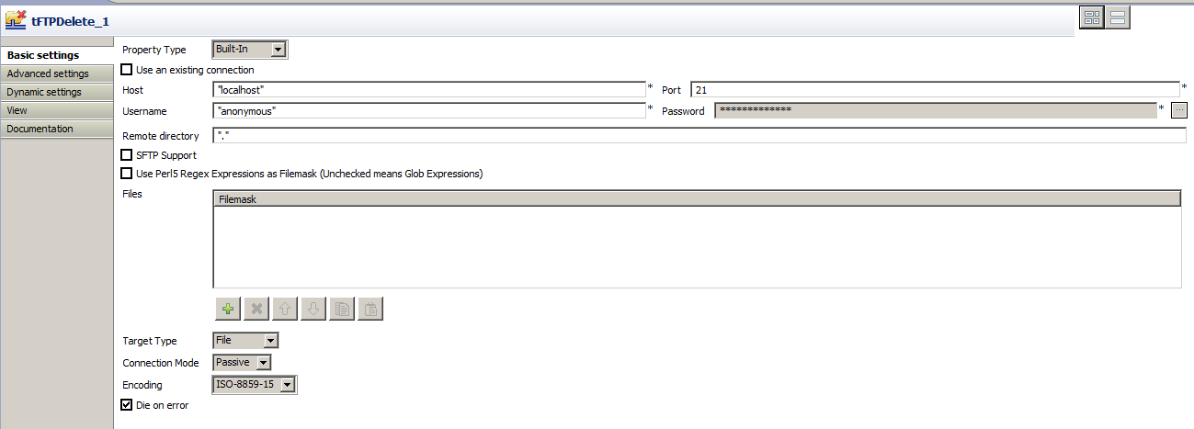
tFTPDelete
This component deletes specified files via an FTP connection.

Slide 14
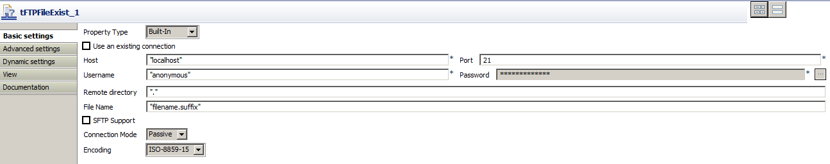
tFTPFileExist
tFTPFileExist checks if a file exists on an FTP server.
Copyright © 2014 by Vikram Takkar. All Rights Reserved..

Slide 15
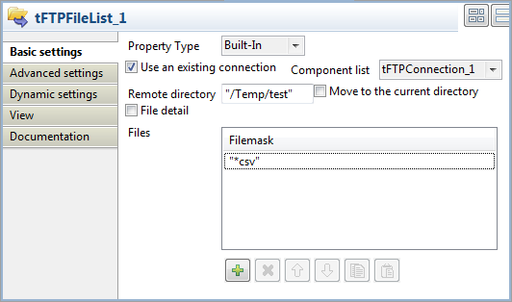
tFTPFileList
tFTPFileList iterates on files and/or folders of a given directory on a remote host.
Copyright © 2014 by Vikram Takkar. All Rights Reserved..

Slide 16
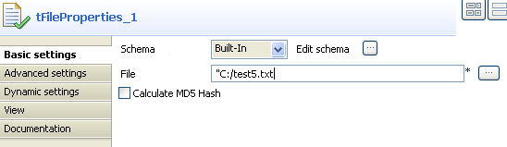
tFTPFileProperties
tFTPFileProperties iterates on files and/or folders of a given directory on a remote host.
Copyright © 2014 by Vikram Takkar. All Rights Reserved..

Slide 17
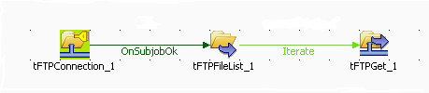
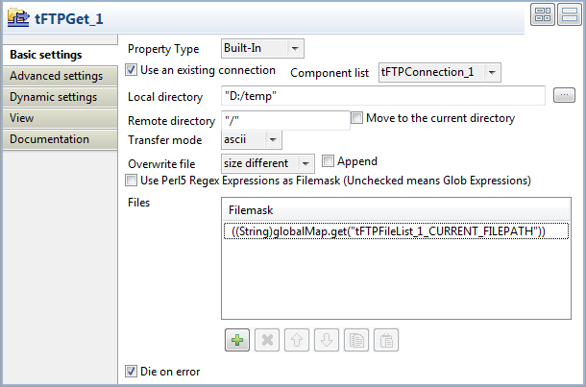
tFTPGet
This component retrieves specified files via an FTP connection. It retrieves selected files from a defined remote FTP directory and cop them to a local directory.
Copyright © 2014 by Vikram Takkar. All Rights Reserved..

Slide 18
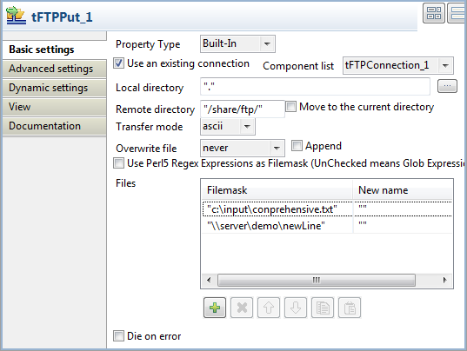
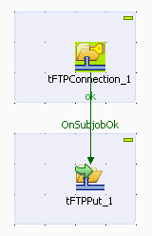
tFTPPut
This component copies selected files via an FTP connection.
Copyright © 2014 by Vikram Takkar. All Rights Reserved..

Slide 19

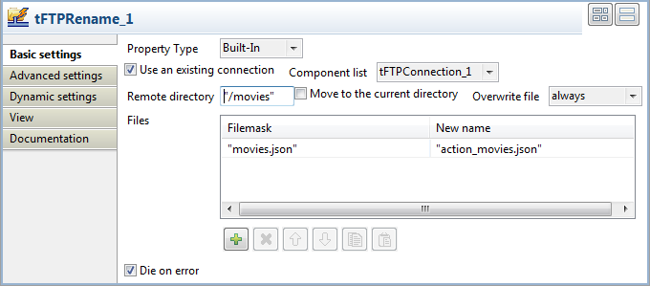
tFTPRename
tFTPRename renames the selected files via an FTP connection.
Copyright © 2014 by Vikram Takkar. All Rights Reserved..

Slide 20
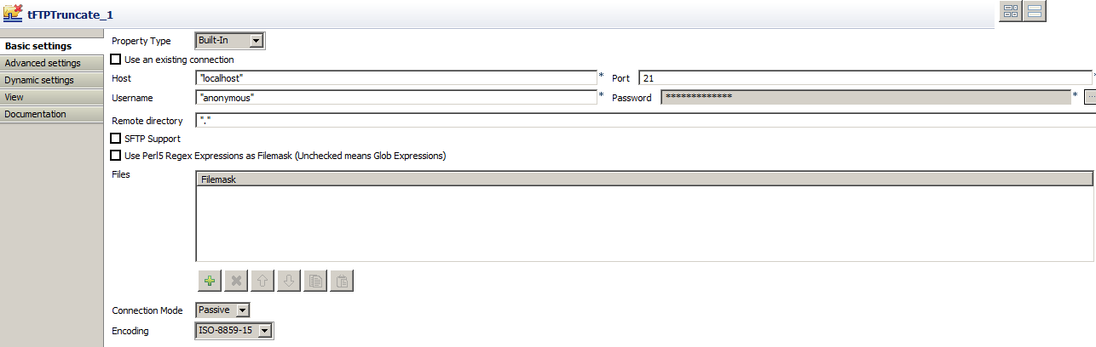
tFTPTruncate
tFTPTruncate truncates the selected files via an FTP connection.

Slide 21
Questions?
Copyright © 2014 by Vikram Takkar. All Rights Reserved..

